Slide 1
Equation Stories

Slide 2
Name: Jane Smith Sample (1)
Tell Story: I was making dinner with my boyfriend and we needed to buy chicken for the recipe. We found out that chicken costs about $3.50 per pound.
Define Variables: c - pounds of chicken
P - price for chicken
Write Equation: P=3.5c
Ask a question: If I paid $7.59 for chicken, how many pounds of chicken did I purchase?
Solve Equation: 7.59=3.5c division prop of equality to isolate variable
2.16 lbs=c
Write answer as a complete sentence: If I paid $7.59 for chicken, then I bought 2.16 lbs of chicken.

Slide 3

Name: Jane Smith Sample (2)
Tell Story: I was making dinner with my boyfriend and we needed to buy chicken for the recipe. We found out that chicken costs about $1.50 per pound.
Define Variables: c - pounds of chicken
P - price for chicken
Write Equation: P=1.5c
Ask a question: How much would it cost to by 4 lbs of chicken
Solve Equation: P=1.5(4) multiplication property to evaluate
P=$6
Write answer as a complete sentence: If I purchase 4 lbs of chicken, I will pay $6.

Slide 4
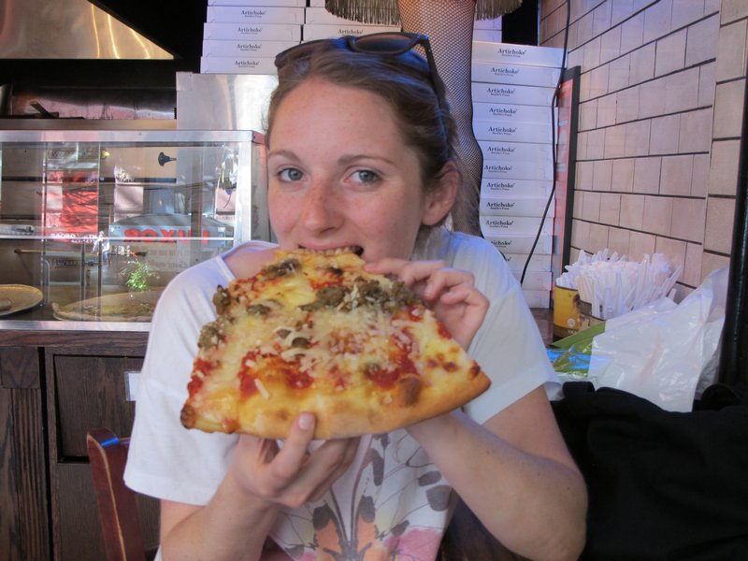
Name: Jane Smith Sample(3)
Tell Story: I went to a New York pizza by the slice restaurant and found out it cost $5.00 per slice plus $0.50 per topping.
Define Variables: t - number of toppings
C - cost for pizza slice
Write Equation: 5.00+0.50t=C
Ask a question: If the cost was $20, how many toppings did I get?
Solve Equation: 20=5.00+0.50t subtraction prop of equality to isolate variable term
15=0.5t division prop of equality to isolate variable
t=30 toppings
Write answer as a complete sentence: Buying a slice of pizza with 30 toppings cost $20.

Slide 5
Name:
Tell Story:
Define Variables:
Write Equation:
Ask a question:
Solve Equation:
Write answer as a complete sentence:

Slide 6
Name:
Tell Story:
Define Variables:
Write Equation:
Ask a question:
Solve Equation:
Write answer as a complete sentence:

Slide 7
Name:
Tell Story:
Define Variables:
Write Equation:
Ask a question:
Solve Equation:
Write answer as a complete sentence:

Slide 8
Name:
Tell Story:
Define Variables:
Write Equation:
Ask a question:
Solve Equation:
Write answer as a complete sentence:

Slide 9
Name:
Tell Story:
Define Variables:
Write Equation:
Ask a question:
Solve Equation:
Write answer as a complete sentence:

Slide 10
Name:
Tell Story:
Define Variables:
Write Equation:
Ask a question:
Solve Equation:
Write answer as a complete sentence:

Slide 11
Name:
Tell Story:
Define Variables:
Write Equation:
Ask a question:
Solve Equation:
Write answer as a complete sentence:

Slide 12
Name:
Tell Story:
Define Variables:
Write Equation:
Ask a question:
Solve Equation:
Write answer as a complete sentence:

Slide 13
Name:
Tell Story:
Define Variables:
Write Equation:
Ask a question:
Solve Equation:
Write answer as a complete sentence:

Slide 14
The End

